Slide 1
Passion Week / Holy Week
The time from Palm Sunday through Easter Sunday

Slide 2
Luke 21
Holy Week
Timeline

Slide 3
Luke 21
Holy Week
Timeline
Jesus spent 4 days (Sunday - Wednesday) teaching in the temple.
Why?

Slide 4
Luke 21
^
Lamb Selection
Day 10th of Nissan
4 days Jesus presented Himself in the temple, showing He was the spotless lamb without defect.
Holy Week
Timeline
“On the tenth day of this month every man shall take for himself a lamb, according to the house of his father, a lamb for a household… Your lamb shall be without blemish, Now you shall keep it until the fourteenth day of the same month. Then the whole assembly of the congregation of Israel shall kill it at twilight…” Exodus 12:32-6

Slide 5
Gospel of Luke, Chapter 21

Slide 6
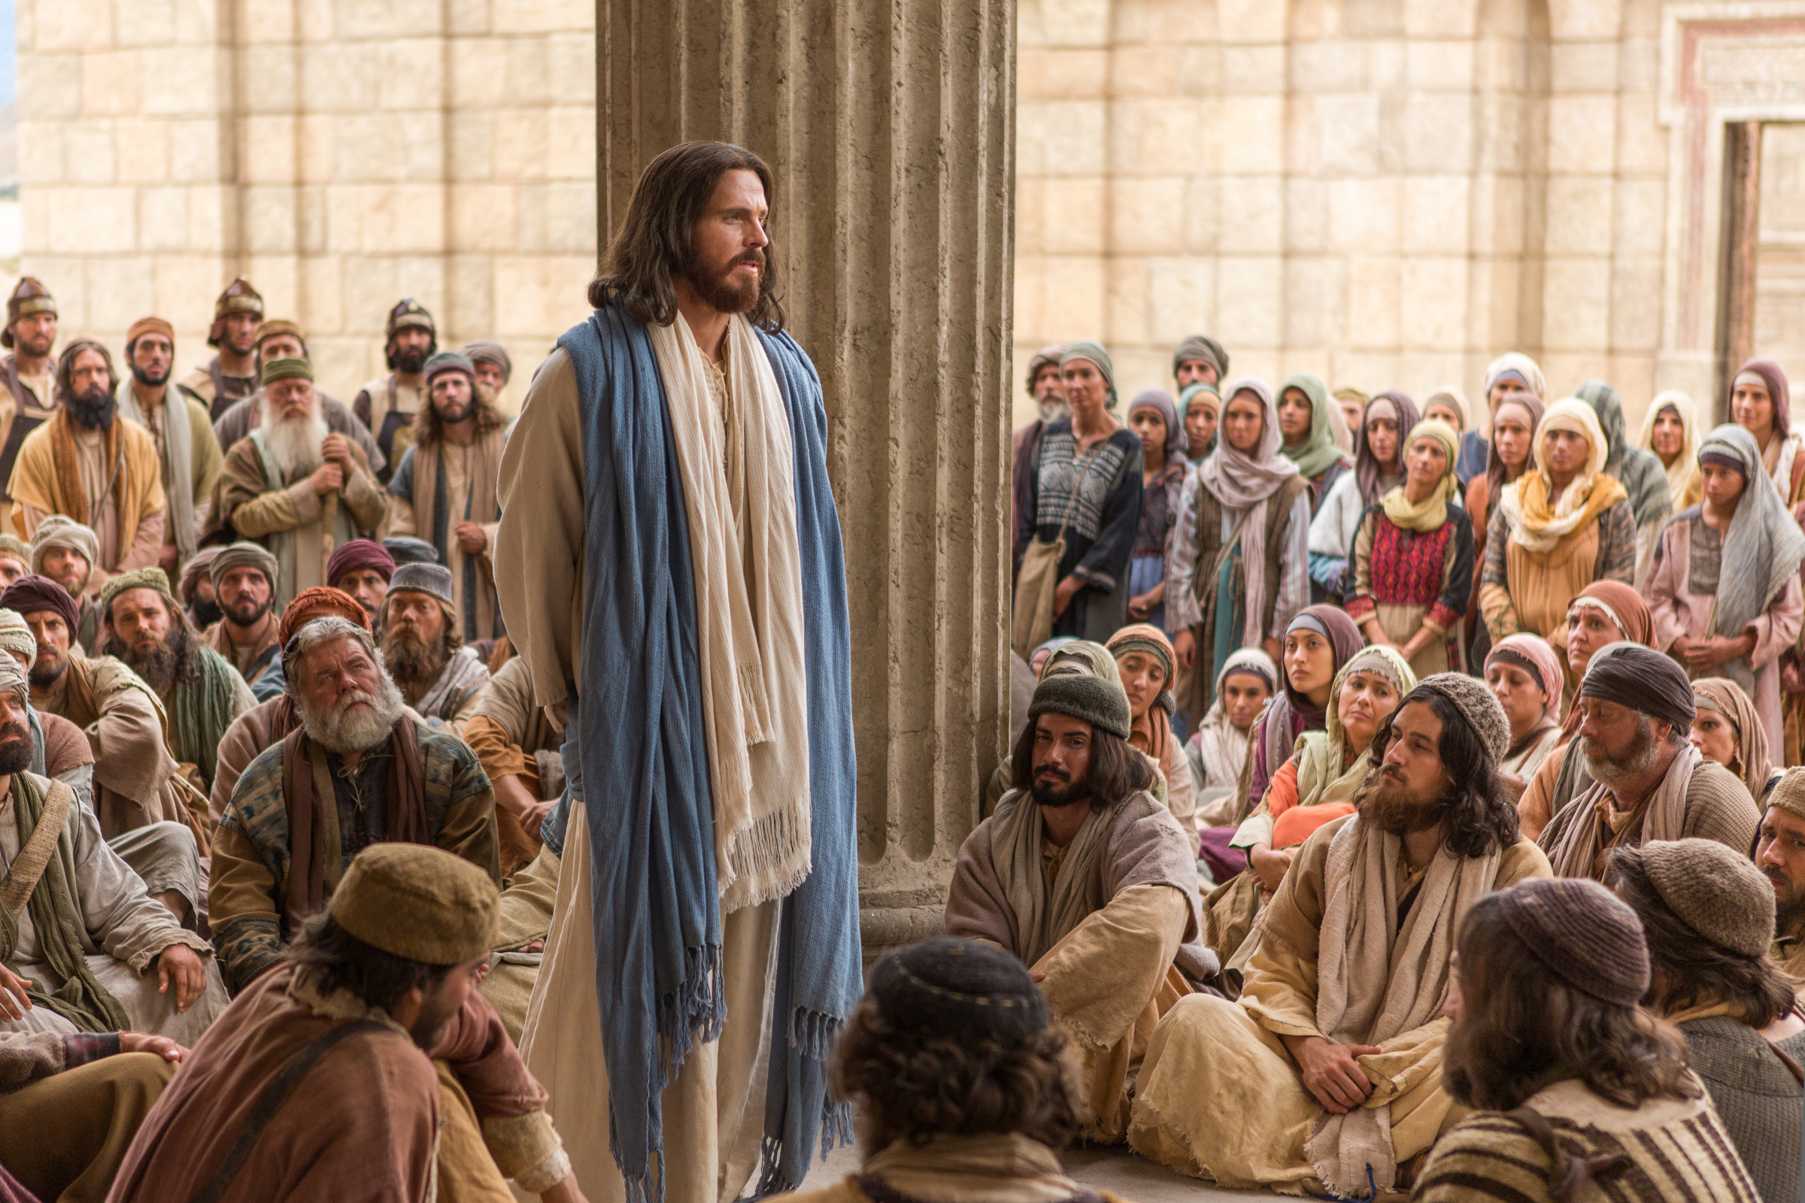
Luke Chapter 21
We find Jesus again
today, teaching His
disciples and the people in the temple at Jerusalem.
Read Luke 21:1-4

Slide 7
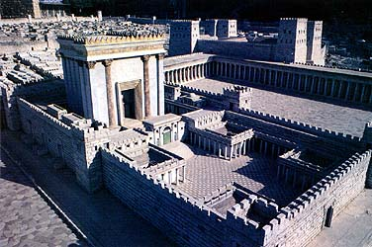
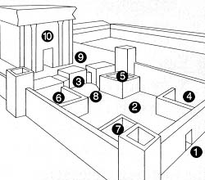
Temple of Herod – In Luke 21, Jesus was teaching inside the court of women
2
View of the inner Temple from its southeast corner: (1) The Beautiful Gate. (2) Court of the Women (3) Nicanor Gate, named after the Egyptian Jew who donated the gate to the Temple. (4) Wood store. (5) Private bath where lepers could ritually purify themselves. (6) Oil store. (7) The chamber where Nazarites—those who had made special vows—could prepare their sacrifices. (8) Steps to the Nicanor Gate. (9) Inner Court. (10) The Holy Place.

Slide 8
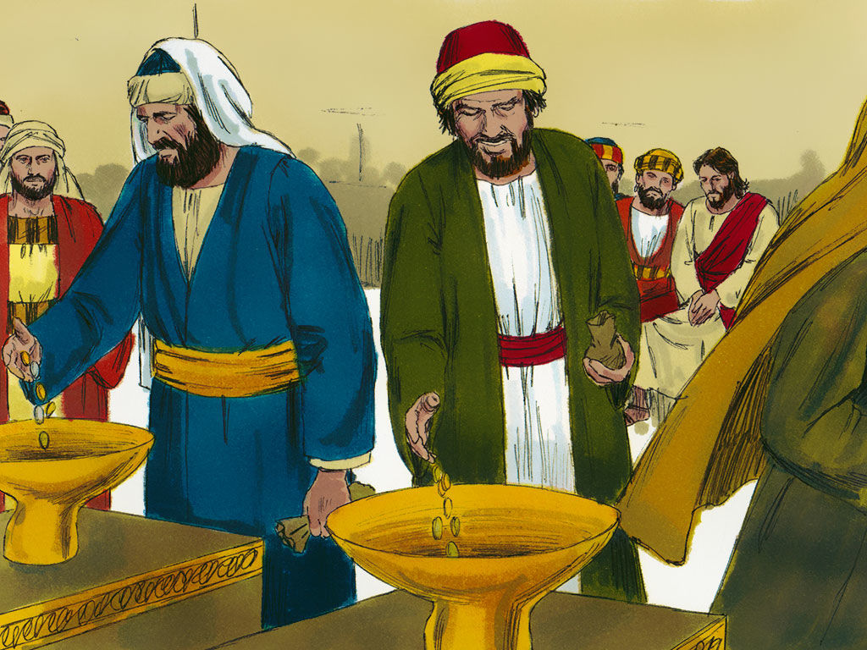
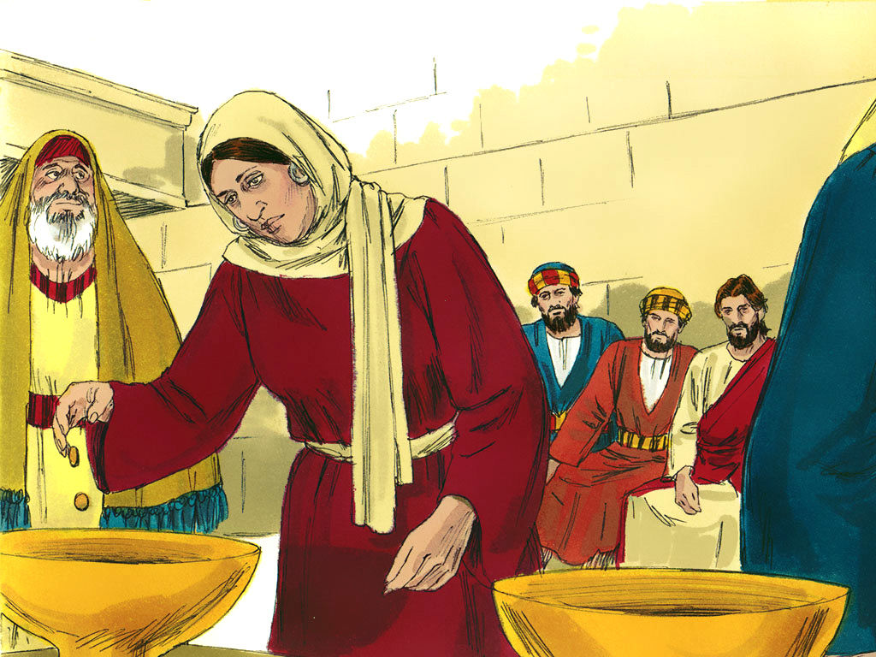
Jesus, “saw the rich putting their gifts into the treasury, and He saw also a certain poor widow putting in two mites.” Luke 21:1-2

Slide 9
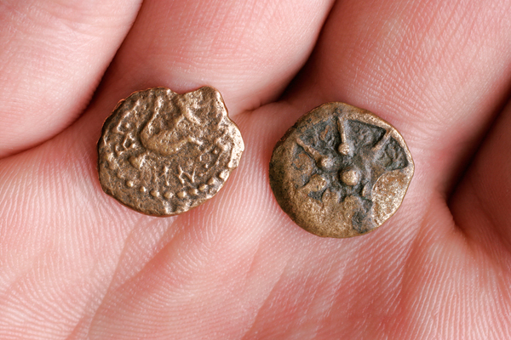
The Widows Two Mites
These 2 copper coins (lepta),
were the smallest of coins in
circulation, worth less than
one hundredth of a denarius.
In Christ’s day:
1 pound of grapes cost 120 lepta
On avg. 80 grapes per/pound
The widow could have only
bought 3 grapes with her coins!

Slide 10
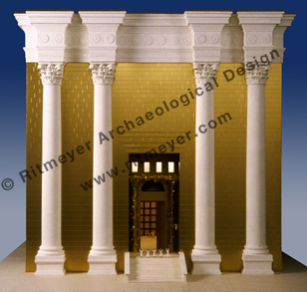
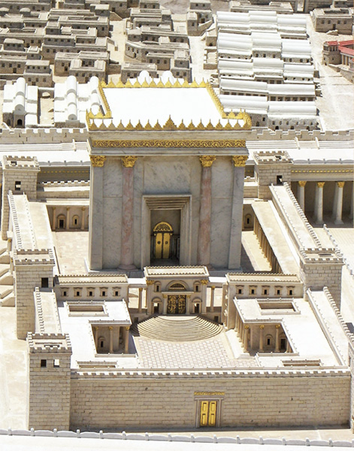
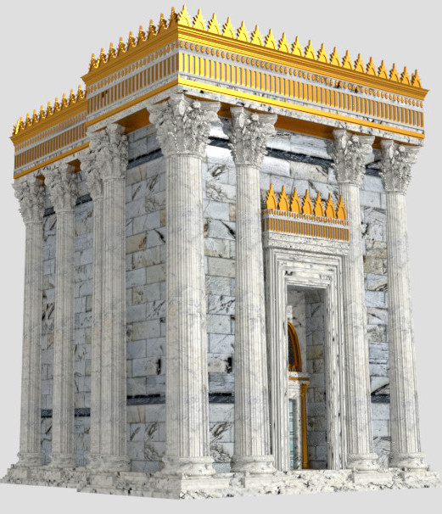
The Temple in Jerusalem – Herod’s Temple (artists depictions)

Slide 11
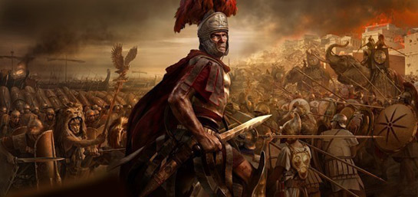
Jesus prophesies the temple’s destruction.
Luke 21:6 “not one stone shall be left upon another that shall not be thrown down.”
40 years later, in 70 A.D. , there was a widespread Jewish revolution against the Romans. Ultimately Rome crushed the rebels; and Jerusalem was leveled, including the temple. Just as Jesus said!

Slide 12
Jesus says this Gentile occupation would continue for a prescribed time period. This He refers to as “the time of the Gentiles”. (It’s the time from the destruction of the Temple in 70 AD, to His 2nd coming). We’re still in it!
The Church Age
“The time of the Gentiles”

Slide 13
The Second Coming of
Jesus Christ
Read Luke 21:25-36
Revelation 1:7 says, “every eye will see Him”

Slide 14
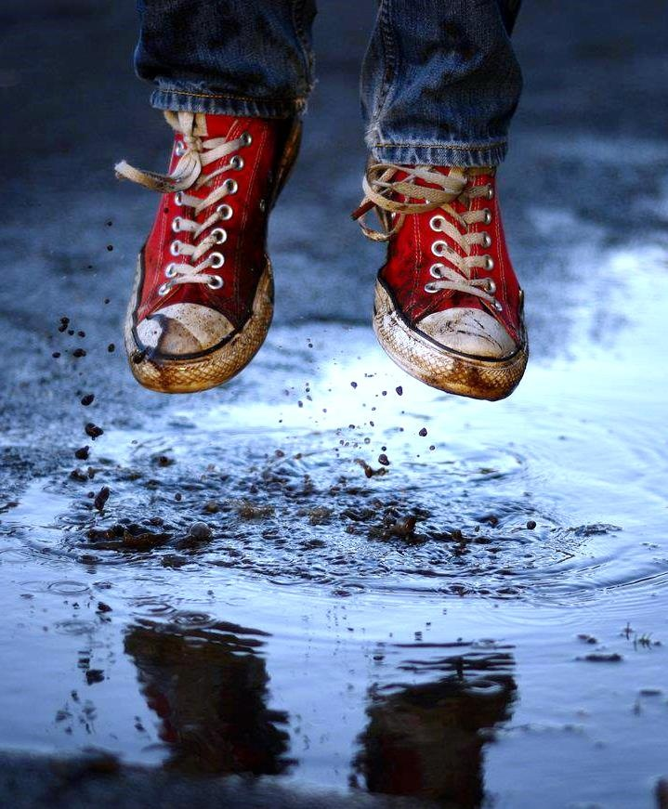
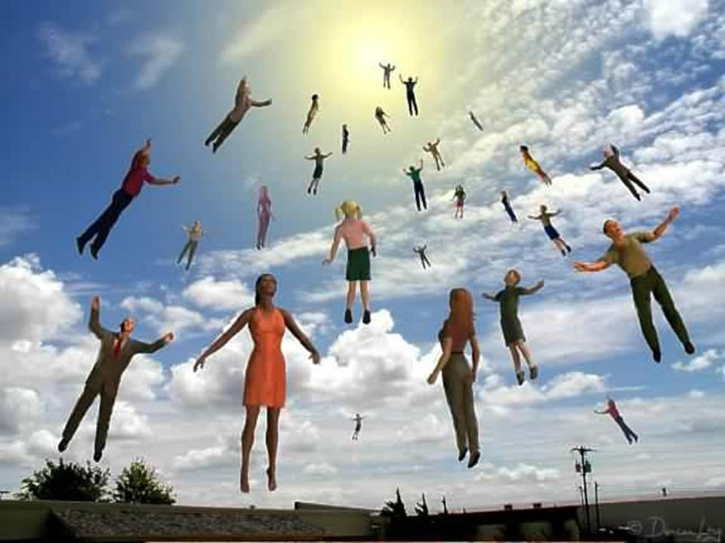
The Rapture: refers to the transporting of believers to heaven at before the Second Coming of Christ. (1 Thessalonians 4:13-18)

Slide 15
VS
The Rapture The Second Coming
of Jesus Christ
Believers meet the Lord in the air. 1 Thess. 4:16-17 Believers return with the Lord to the earth. Rev. 19:4
Occurs before the tribulation. 1 Thess. 5:9, Rev. 3:10 Occurs after the great and terrible tribulation. Rev. Ch. 6-12
The removal of believers from the earth (deliverance) Includes the removal of unbelievers as an act of judgment
1 Thess. 4:13-17, 5:9 Matt. 24:40-41
Will be secret and instant. 1 Cor. 15:50-54 Will be visible to all. Rev. 1:7, Matt. 24:29-30, Luke 21:27
Is imminent; it could take place at any moment Will not occur until after certain other end-times events Titus 2:13, 1 Thess. 4:13-18, 1 Cor. 15:50-54 take place. 2 Thess. 2:4, Matt. 24:15-30, Rev. Ch. 6-18

Slide 16
Biblical Timeline
The Church Age
“The time of the Gentiles”

