Slide 1
Introduction to:
Spiritual Gifts

Slide 2
Introduction to:
Spiritual Gifts
“Every good gift and every perfect gift
is from above, and comes down from
the Father of lights, with whom there
is no variation or shadow of turning.”
James 1:17

Slide 3
“Now concerning spiritual gifts, brethren, I would not have
you ignorant.”
1 Corinthians 12:1
Synonyms for Ignorant ...

Slide 4
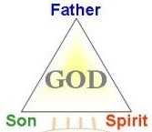
Father
Son Spirit

Slide 5
“There are diversities of gifts, but the same Spirit. There are differences of ministries, but the same Lord. And there are diversities of activities, but it is the same God who works all in all. But the manifestation of the Spirit is given to each one for the profit of all.” 1 Corinthians 12:4-7

Slide 6
Gifts from the Spirit, 1 Corinthians 12:7-11 (Supernatural Gifts)
“There are diversities of gifts, but the same Spirit. There are differences of ministries, but the same Lord. And there are diversities of activities, but it is the same God who works all in all. But the manifestation of the Spirit is given to each one for the profit of all.” 1 Corinthians 12:4-7

Slide 7
Gifts from the Spirit, 1 Corinthians 12:7-11 (Supernatural Gifts)
Ministries from Jesus, the Son, Ephesians 4:11 (5-Fold Gifts)
“There are diversities of gifts, but the same Spirit. There are differences of ministries, but the same Lord. And there are diversities of activities, but it is the same God who works all in all. But the manifestation of the Spirit is given to each one for the profit of all.” 1 Corinthians 12:4-7

Slide 8
Gifts from the Spirit, 1 Corinthians 12:7-11 (Supernatural Gifts)
Ministries from Jesus, the Son, Ephesians 4:11 (5-Fold Gifts)
Activities from the Father, Romans 12:3-8 (Motivational Gifts)
“There are diversities of gifts, but the same Spirit. There are differences of ministries, but the same Lord. And there are diversities of activities, but it is the same God who works all in all. But the manifestation of the Spirit is given to each one for the profit of all.” 1 Corinthians 12:4-7

Slide 9
Gifts of the Father: (the motivational gifts)
Romans 12:6-8 NLT “In his grace, God has given us different gifts for doing certain things well. So, if God has given you the ability to prophesy, speak out with as much faith as God has given you. If your gift is serving others, serve them well. If you are a teacher, teach well. If your gift is to encourage others, be encouraging. If it is giving, give generously. If God has given you leadership ability, take the responsibility seriously. And if you have a gift for showing mercy to others, do it gladly.”

Slide 10
Prophecy - Quick to speak, declares the truth, see things as black or white.

Slide 11
Prophecy - Quick to speak, declares the truth, see things as black or white.
Server - (Servant) Sees the needs of others and desires to meet them.

Slide 12
Prophecy - Quick to speak, declares the truth, see things as black or white.
Server - (Servant) Sees the needs of others and desires to meet them.
Teacher - Loves to research facts, history, and to communicate knowledge.

Slide 13
Prophecy - Quick to speak, declares the truth, see things as black or white.
Server - (Servant) Sees the needs of others and desires to meet them.
Teacher - Loves to research facts, history, and communicate knowledge.
Encourager - Desires to build up and encourage others.

Slide 14
Prophecy - Quick to speak, declares the truth, see things as black or white.
Server - (Servant) Sees the needs of others and desires to meet them.
Teacher - Loves to research facts, history, and communicate knowledge.
Encourager - Desires to build up and encourage others.
Giver - Gifted at making money, desires to give both time and money to those in need.

Slide 15
Prophecy - Quick to speak, declares the truth, see things as black or white.
Server - (Servant) Sees the needs of others and desires to meet them.
Teacher - Loves to research facts, history, and communicate knowledge.
Encourager - Desires to build up and encourage others.
Giver - Gifted at making money, desires to give both time and money to those in need.
Leader - Gifted to lead. Are quick to delegate and take steps to solve problems.

Slide 16
Prophecy - Quick to speak, declares the truth, see things as black or white.
Server - (Servant) Sees the needs of others and desires to meet them.
Teacher - Loves to research facts, history, and communicate knowledge.
Encourager - Desires to build up and encourage others.
Giver - Gifted at making money, desires to give both time and money to those in need.
Leader - Gifted to lead. Are quick to delegate and take steps to solve problems.
Mercy - Full of compassion, focused on emotional needs of others. Are empathic.

Slide 18
Read - 1 Corinthians 12:14-22
“But now indeed there are many members, yet one body.”

Slide 19
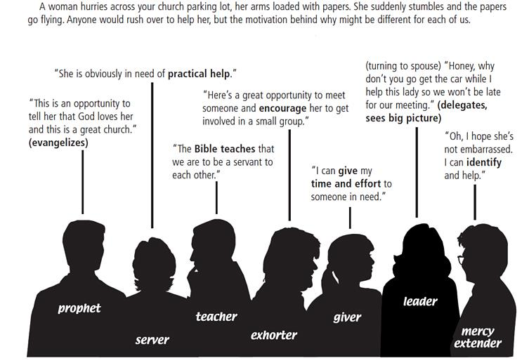
The Motivational Gifts at Work...
Oh, let me help you clean it up.
Jim get the broom and a dust-pan, Sarah
make sure she is physically alright. Larry
check to see if we have enough desserts
without it.
I’m so sorry you fell, and don’t worry,
about your dessert, we always have
more than enough.
That’s what happens when you
run late. You need to leave earlier.
Jesus never was in a hurry.
Are you OK? You poor thing!
You spent a lot of time
making that dessert. You
known I’ve already done
the same thing!
Next time you’ll need to
consider making something
easier to carry.
If you want, I can pick up a
replacement dessert at the
corner store.

Slide 20
Gifts of the Holy Spirit

Slide 21
Gifts of the Holy Spirit
“But one and the same Spirit works all these things, distributing to each one
individually as He wills.” 1 Corinthians 12:11

Slide 22
1 Corinthians 12:7-11 “But the manifestation of the Spirit is given to each one for the profit of all: for to one is given the word of wisdom through the Spirit, to another the word of knowledge through the same Spirit, to another faith by the same Spirit, to another gifts of healings by the same Spirit, to another the working of miracles, to another prophecy, to another discerning of spirits, to another different kinds of tongues, to another the interpretation of tongues. But one and the same Spirit works all these things, distributing to each one individually as He wills”.

Slide 23
9 Supernatural Gifts of the Holy Spirit:
Revelation Gifts:
Power Gifts:
Vocal or Speaking Gifts:

Slide 24
9 Supernatural Gifts of the Holy Spirit:
Revelation Gifts:
Word of wisdom
Word of knowledge
Discerning of spirits

Slide 25
9 Supernatural Gifts of the Holy Spirit:
Revelation Gifts:
Power Gifts:
Word of wisdom
Faith
Word of knowledge
Gifts of healings
Discerning of spirits
Working of miracles

Slide 26
9 Supernatural Gifts of the Holy Spirit:
Revelation Gifts:
Power Gifts:
Vocal or Speaking Gifts:
Word of wisdom
Faith
Prophecy
Word of knowledge
Gifts of healings
Different kinds of tongues
Discerning of spirits
Working of miracles
Interpretation of tongues

Slide 27
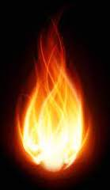
“Therefore, brethren, seek out from among you seven men of good reputation, full of the
Holy Spirit and wisdom, whom we may appoint over this business.” Acts 6:3

Slide 28
Acts 8:14-17
“Now when the apostles who were at Jerusalem heard that Samaria had received the word of God, they sent Peter and John to them, who, when they had come down, prayed for them that they might receive the Holy Spirit. For as yet He had fallen upon none of them. They had only been baptized in the name of the Lord Jesus. Then they laid hands on them, and they received the Holy Spirit.”
Acts 8:14-17
“Therefore, brethren, seek out from among you seven men of good reputation, full
of the Holy Spirit and wisdom, whom we may appoint over this business.” Acts 6:3

Slide 30
“And He (Jesus) Himself gave some to be apostles, some prophets, some evangelists, and some pastors and teachers, for the equipping of the saints for the work of ministry, for the edifying of the body of Christ, till we all come to the unity of the faith and of the knowledge of the Son of God, to a perfect man, to the measure of the stature of the fullness of Christ.”
Gifts of Jesus
Ephesians 4:11-13

Slide 31
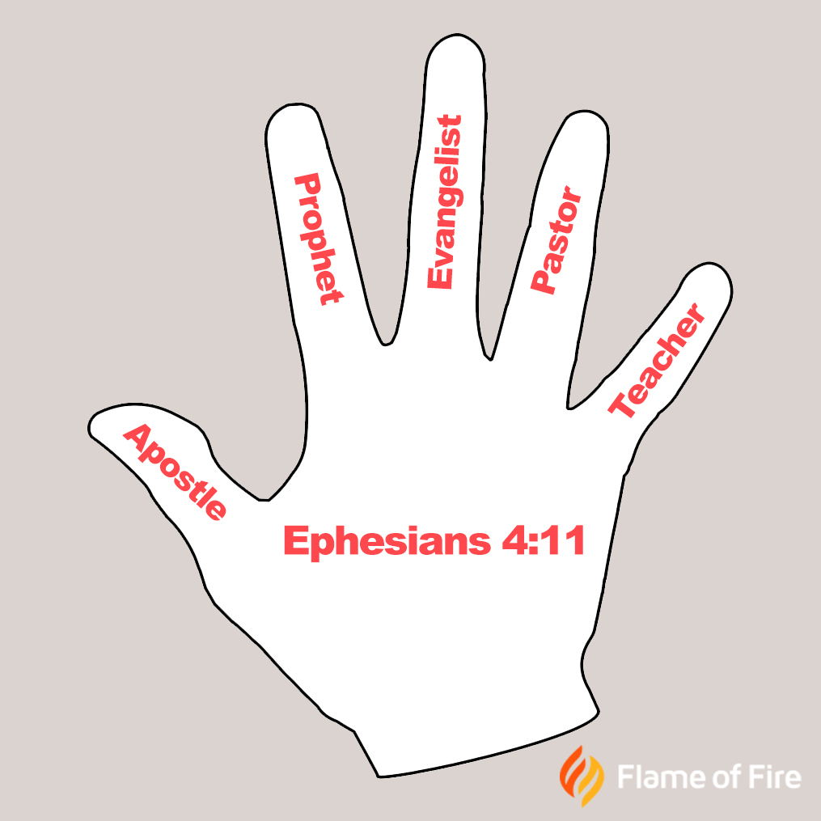
The Gifts of Jesus
The 5-Fold Gifts

Slide 32
The Gifts of Jesus
The 5-Fold Gifts
Apostle – Are spiritual fathers to specific regions or people with spiritual authority.

Slide 33
The Gifts of Jesus
The 5-Fold Gifts
Apostle – Are spiritual fathers to specific regions or people with spiritual authority.
Prophet – Are called to speak out what Jesus wants said. They are His mouthpiece.

Slide 34
The Gifts of Jesus
The 5-Fold Gifts
Apostle – Are spiritual fathers to specific regions or people with spiritual authority.
Prophet – Are called to speak out what Jesus wants said. They are His mouthpiece.
Evangelist – Has a burden for the lost. Anointed to preach drawing the unsaved to the Lord.

Slide 35
The Gifts of Jesus
The 5-Fold Gifts
Apostle – Are spiritual fathers to specific regions or people with spiritual authority.
Prophet – Are called to speak out what Jesus wants said. They are His mouthpiece.
Evangelist – Has a burden for the lost. Anointed to preach drawing the unsaved to the Lord.
Pastor – Shepherd, to help the sheep, to feed them and help them to grow.

Slide 36
The Gifts of Jesus
The 5-Fold Gifts
Apostle – Are spiritual fathers to specific regions or people with spiritual authority.
Prophet – Are called to speak out what Jesus wants said. They are His mouthpiece.
Evangelist – Has a burden for the lost. Anointed to preach drawing the unsaved to the Lord.
Pastor – Shepherd, to help the sheep, to feed them and help them to grow.
Teacher – Anointed to teach and illuminate
the Word to edify us.

Slide 37
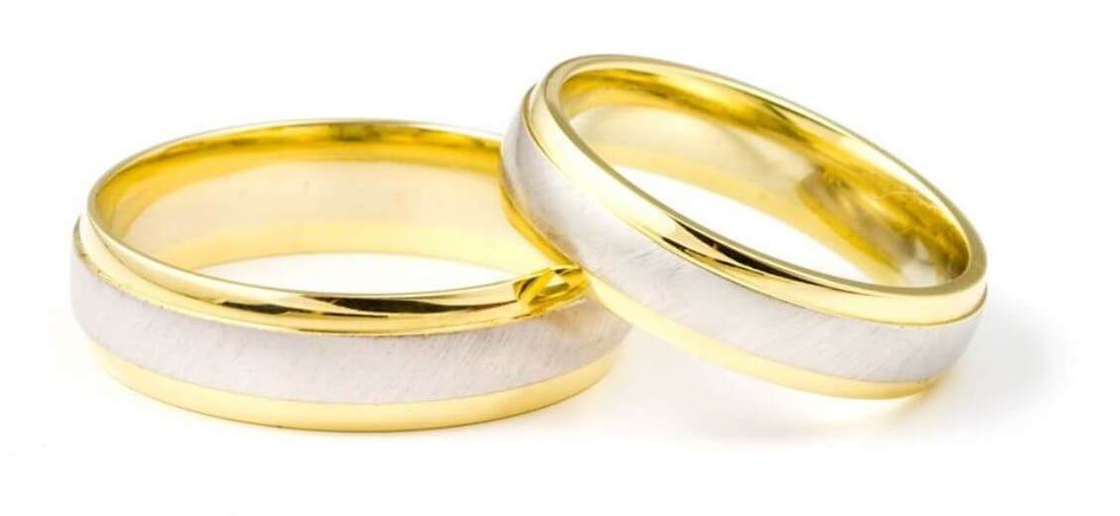
Jesus is seeking a
virtuous, beautiful
Bride without spot
or wrinkle...

Slide 38
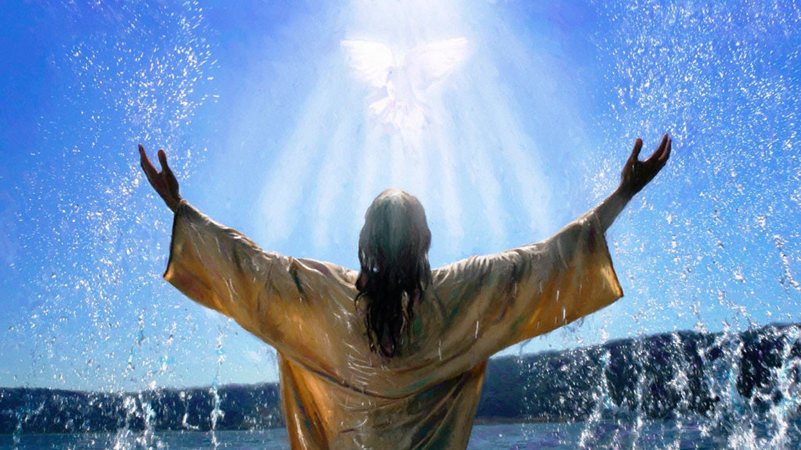

Slide 39
Philippians 2:6-8 “Though He was God, did not demand His rights as God, but laid aside His mighty power and glory, taking the disguise of a slave and becoming like men.”

Slide 40
John 14:12 “Most assuredly, I say to you, he who believes in Me, the works that I do he will do also; and greater works than these he will do, because I go to My Father.”

